Slide 1
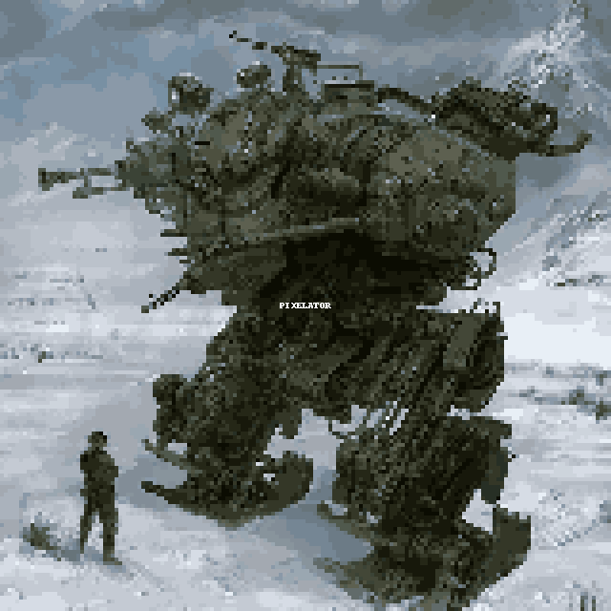
ART for Cutscenes
Cutscenes done in pixel style

Slide 2
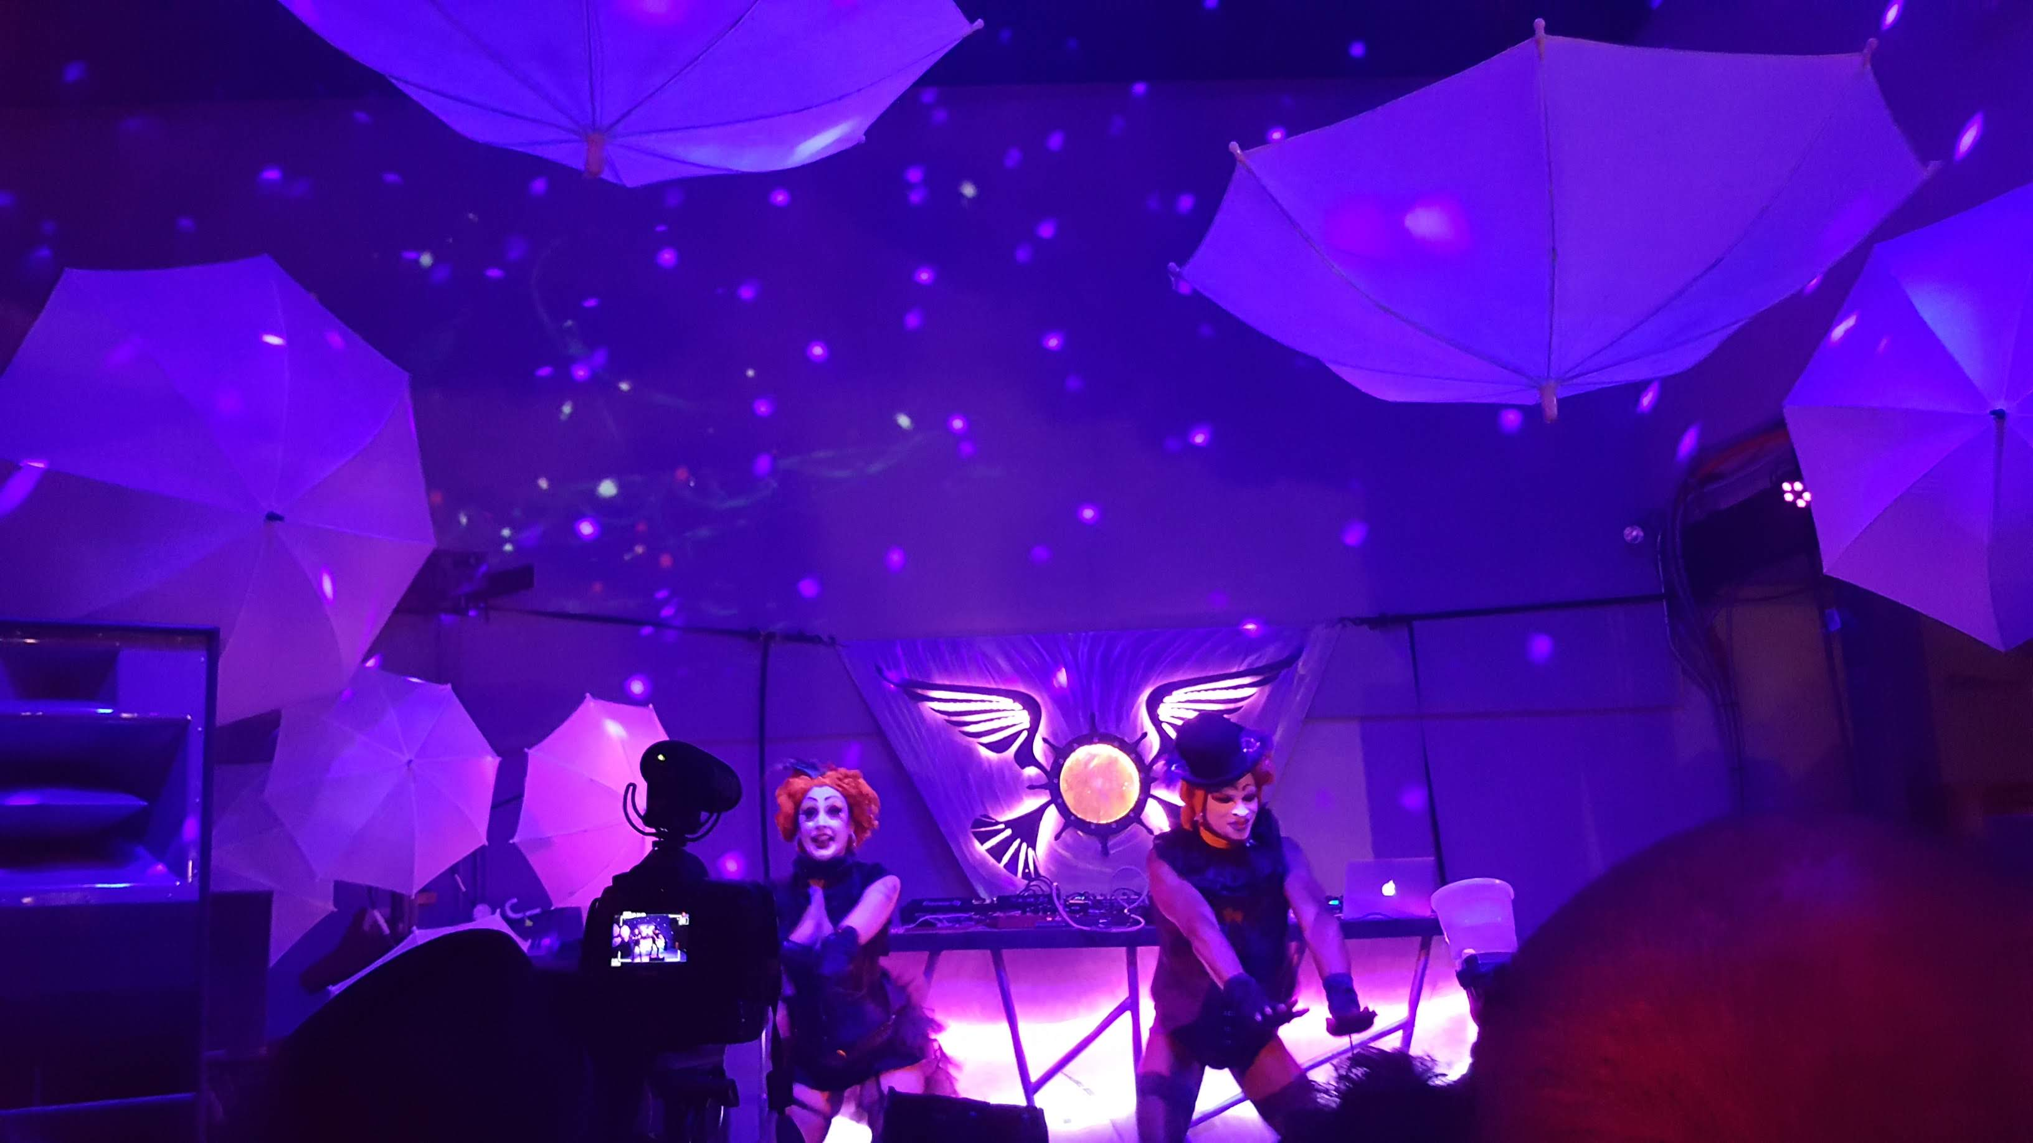

Music
Epic music tracks from movies
hand crafted scores for levels

Slide 3
Story

Slide 5

Story
Possibility of branched storyline.
Bullet Hell with a good plot

Slide 6

Changes due to Playtesting
Got rid of ESP
Simplified branches of story
More backstory on Percival

